Slide 1
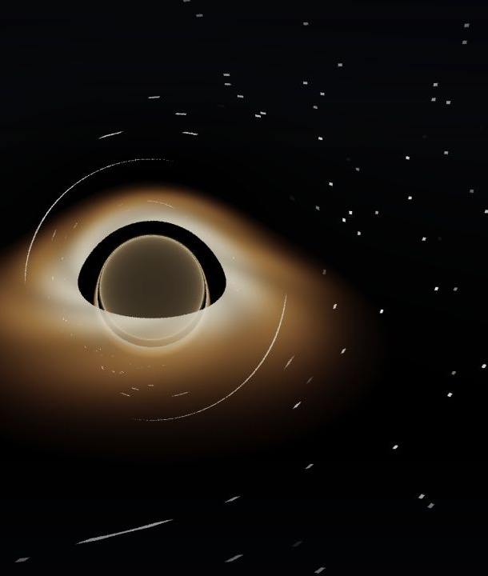
VAC PROJECT DOCUMENTATION
A black hole,
traced one pixel
at a time
How the WebGL2 Schwarzschild geodesic simulation works — from spacetime geometry to the final image.
PHYSICAL RAY PATHS · ILLUSTRATIVE EMISSION
Code snapshot 6904ea0
Notes:
Open by framing the project accurately: the shader traces null geodesics through a fixed Schwarzschild spacetime in real time. The ray bending is the scientific core; the accretion-disk appearance is intentionally illustrative.
[Sources]
- Blackhole Simulation/README.md:1-29
- Blackhole Simulation/shaders/fragment.glsl:14-21,54-71
- /private/tmp/vac-blackhole-default.jpg (runtime capture from the project)
[/Sources]

Slide 2
SCOPE
The project is a fixed-spacetime ray tracer
The camera asks a single question for every pixel:
WHAT IT DOES
Where would this light ray go near a non-rotating black hole?
Integrates null-geodesic paths
Uses Schwarzschild landmark radii
Shows capture, disk crossings, and escape
Runs interactively in a WebGL2 fragment shader
WHAT IT DOES NOT DO
It does not evolve spacetime, solve Einstein’s field equations on a grid, or simulate accretion fluid dynamics.
NOT NUMERICAL RELATIVITY
02
Notes:
This boundary matters. The project is scientifically meaningful without claiming to be a full numerical-relativity code. It computes test-particle light paths in a prescribed Schwarzschild geometry and layers a procedural emission model on top.
[Sources]
- Blackhole Simulation/shaders/fragment.glsl:14-21,54-71,97-159
- Blackhole Simulation/js/main.js:177-212
[/Sources]

Slide 3
PIPELINE
One pixel becomes one curved light path
01
02
03
04
05
Pixel
Camera ray
RK2 trace
Scene event
Final color
The full-screen triangle invokes the fragment shader.
A finite-distance camera basis maps UV to origin + direction.
The shader advances position and direction through curvature.
A ray is captured, crosses the disk, or escapes to stars.
Emission, tone mapping, gamma, and vignette produce the pixel.
The scene is generated procedurally — there is no mesh model of the black hole or disk.
03
Notes:
Walk left to right. A single full-screen triangle ensures every output pixel runs the same fragment program. The camera constructs a ray; the trace loop integrates it; discrete events add or terminate light; post-processing converts the accumulated linear color to the display image.
[Sources]
- Blackhole Simulation/shaders/vertex.glsl:4-15
- Blackhole Simulation/shaders/fragment.glsl:73-95,97-188
- Blackhole Simulation/js/main.js:157-175
[/Sources]

Slide 4
GEOMETRY
Four radii organize the simulated scene
2M
Event-horizon radius
Rays crossing the 2.04M guard are terminated as captured.
3M
Photon sphere
The unstable circular light orbit organizes the strongest bending.
2M
6M
Disk inner edge / ISCO
The illustrative thin disk begins at the Schwarzschild ISCO.
18M
Disk outer edge
The modeled emission annulus ends here.
Geometric units: M = 1 · schematic, not to scale
04
Notes:
The simulation normalizes the black-hole mass to M equals one. This makes the Schwarzschild radius 2M, the photon sphere 3M, and the non-rotating ISCO 6M. The 18M radius is a scene-design choice for the outer disk, not a universal physical boundary.
[Sources]
- Blackhole Simulation/shaders/fragment.glsl:14-21,105-118,129-149
- Belbruno and Pretorius (2011): https://arxiv.org/abs/1103.0585
- Bardeen, Press, and Teukolsky (1972): https://doi.org/10.1086/151796
[/Sources]

Slide 5
MATH → CODE
The shader encodes Schwarzschild light bending
SPATIAL EQUATION
GLSL IMPLEMENTATION · LINES 56–62
d²x / dλ² = −3 M L² x / r⁵
vec3 geodesicAccel(vec3 pos, vec3 vel) {
float r2 = dot(pos, pos);
float r = sqrt(max(r2, 1e-6));
vec3 L = cross(pos, vel);
float L2 = max(dot(L, L), 1e-8);
return -1.5 * RS * L2 * pos
/ (r2 * r2 * r);
}
L = x × dx/dλ
Why the coefficient matches
The code uses −1.5 × RS. Because RS = 2M, that becomes exactly −3M.
PHOTON SPHERE EMERGES AT r = 3M
05
Notes:
The central math claim can be checked directly. Belbruno and Pretorius give the same reduced spatial vector equation for Schwarzschild null geodesics. In the shader, the denominator r2 times r2 times r is r to the fifth power, and minus 1.5 times RS equals minus 3M.
[Sources]
- Blackhole Simulation/shaders/fragment.glsl:14-18,54-62
- Belbruno and Pretorius (2011), equation 12: https://arxiv.org/abs/1103.0585
[/Sources]

Slide 6
NUMERICS
Each step uses the explicit midpoint RK2 method
01
02
03
Evaluate the start
Predict the midpoint
Advance from midpoint
a₁ = a(xₙ, vₙ)
xₘ = xₙ + ½hvₙ
vₘ = vₙ + ½ha₁
xₙ₊₁ = xₙ + hvₘ
vₙ₊₁ = vₙ + ha₂
Curvature is computed from the ray’s current position and direction.
A half-step estimate samples acceleration where the step is headed.
The full update uses the midpoint velocity and acceleration.
Step size h = clamp(0.045r, 0.025, 0.4) · maximum 260 iterations per pixel
06
Notes:
Explicit midpoint RK2 is a compact second-order integrator: it spends two acceleration evaluations per step and is practical in a fragment shader. The current implementation chooses step size from radius and caps the trace at 260 iterations; those are engineering choices, not physical constants.
[Sources]
- Blackhole Simulation/shaders/fragment.glsl:20-21,64-71,105-127
- Hairer, Norsett, and Wanner, Solving Ordinary Differential Equations I: https://doi.org/10.1007/978-3-540-78862-1
[/Sources]

Slide 7
TRACE LOOP
Three events determine what a ray contributes
Capture
Disk crossing
Escape
r < 2.04M
6M < r < 18M
r > 70M
The ray is treated as absorbed. No horizon surface is drawn; the dark region is a capture shadow.
A y-plane sign change locates the crossing. Procedural disk emission is added, then transmittance falls.
The ray samples the procedural star field in its final direction and terminates.
MULTIPLE CROSSINGS CAN PRODUCE HIGHER-ORDER DISK IMAGES
07
Notes:
These branch conditions translate the continuous ray path into visible scene events. The word shadow is more accurate than event-horizon surface: the simulation never renders the horizon as material geometry. A ray may cross the thin disk more than once before capture or escape, producing direct and higher-order lensed images.
[Sources]
- Blackhole Simulation/shaders/fragment.glsl:97-159
- Event Horizon Telescope, shadow explanation: https://eventhorizontelescope.org/press-release-april-10-2019-astronomers-capture-first-image-black-hole
[/Sources]

Slide 8
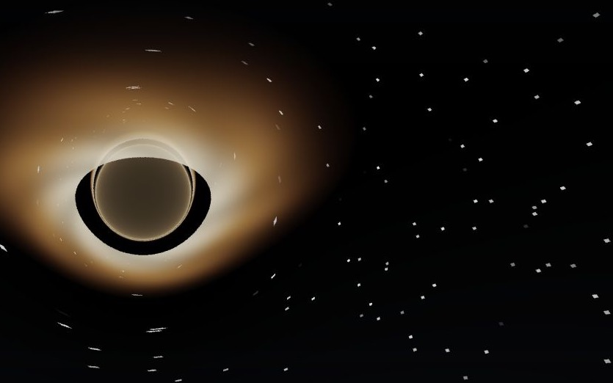
APPEARANCE
A thin disk is seen through strongly bent light
WHAT THE IMAGE IS SHOWING
1
Direct image
Nearby disk light reaches the camera after modest bending.
2
Higher-order images
Additional plane crossings form compressed arcs near the capture boundary.
3
Central shadow
Directions whose rays are captured do not reach the background star field.
The current disk is optically stylized: it is not a fluid simulation or calibrated radiative-transfer model.
08
Notes:
Use this runtime capture to connect the implementation to the visual result. Strong bending lets the observer see multiple images of a geometrically thin disk. The emission and opacity are procedural, so the image should be described as physically motivated rather than observationally calibrated.
[Sources]
- Blackhole Simulation/shaders/fragment.glsl:39-52,129-149
- Cunningham (1975): https://doi.org/10.1086/154033
- /private/tmp/vac-blackhole-edge-on.jpg (runtime capture from the project)
[/Sources]

Slide 9
IMPLEMENTATION
WebGL2 makes the geodesic solver interactive
JavaScript host
Load and compile shaders · update camera uniforms · draw every animation frame
main.js
Full-screen triangle
Generate three clip-space vertices from gl_VertexID — no model mesh required
vertex.glsl
Fragment shader
Construct a ray · integrate up to 260 steps · shade each output pixel
fragment.glsl
Interaction stays outside the math core
Pointer orbit, inertia, wheel zoom, and resize only change the camera uniforms.
09
Notes:
The architecture is deliberately small. JavaScript owns browser integration and camera interaction. The vertex shader emits one full-screen triangle. The fragment shader owns both the ray integration and appearance model. This keeps the solver easy to inspect and lets the GPU process pixels in parallel.
[Sources]
- Blackhole Simulation/js/main.js:34-89,91-175,177-223
- Blackhole Simulation/shaders/vertex.glsl:4-15
- Blackhole Simulation/shaders/fragment.glsl:73-188
[/Sources]

Slide 10
INTERPRETATION
Physical ray paths, illustrative emission
PHYSICS-BASED CORE
ART-DIRECTED LAYER
What can be read literally
What should be described carefully
Schwarzschild landmark radii
Null-geodesic bending and capture
Multiple disk-plane crossings
Interactive changes in viewing geometry
Disk palette, spiral bands, and opacity
The heuristic ‘redshift-ish’ brightness falloff
Photon-sphere glow and procedural stars
ACES-style tone mapping, gamma, and vignette
Not yet modeled: Doppler beaming · rotating (Kerr) spacetime · fluid dynamics · calibrated radiative transfer
10
Notes:
This is the most important interpretation slide. The path equation and landmark geometry have a defensible relativistic basis. The emission choices are visual storytelling. Missing Doppler asymmetry is especially noticeable in an accretion-disk image; adding orbital velocity and invariant intensity transport would be the strongest next fidelity improvement.
[Sources]
- Blackhole Simulation/shaders/fragment.glsl:14-21,39-71,120-188
- Page and Thorne (1974): https://doi.org/10.1086/152990
- Cunningham (1975): https://doi.org/10.1086/154033
[/Sources]

Slide 11
CONFIDENCE
Validation should separate solver error from visual style
REFERENCE
CONVERGENCE
REGRESSION
CPU double-precision paths
Invariants + step halving
Fixed-camera image baselines
Compare selected rays, deflection angles, and near-critical trajectories against an offline solver.
Track angular momentum and verify that smaller steps approach the same path and event outcome.
Keep deterministic views for the shadow edge, photon-ring region, and disk-image structure.
Current audit signal
A fixed 260-step budget can end some long rays before capture or escape; at large camera distance this can create false dark pixels.
11
Notes:
The current visual demo runs cleanly, but formal solver validation is not present in the repository. An exploratory read-only emulation of the exact shader loop found that budget exhaustion rises sharply at the 55M maximum camera distance. Treat that as a targeted audit signal, not as a universal screen-space error rate.
[Sources]
- Blackhole Simulation/shaders/fragment.glsl:20-21,105-127,151-158
- Exploratory audit recorded in VAC_Schwarzschild_Simulation_Technical_Report.docx, section 11
[/Sources]

Slide 12
ROADMAP
Add fidelity in measured stages
01
Validate the integrator
02
Correct light transport
Reference rays, invariants, step-halving studies, and deterministic image tests.
Observer tetrad, frequency shift, and invariant intensity transport.
03
Improve the disk
04
Add Kerr spacetime
Orbital velocity, Doppler beaming, and an emissivity / temperature model.
Spin, frame dragging, and Kerr null geodesics while retaining ray tracing.
05
Tune quality and controls
Separate horizon
A full numerical-relativity solver would be a different project, not the next shader feature.
Error-controlled stepping, optional supersampling, reset, pause, and quality modes.
12
Notes:
The ordering protects what already works. First measure the current solver. Then make brightness physically interpretable, add the strongest missing disk asymmetry, and only then extend the spacetime to Kerr. Numerical relativity remains a separate class of system because it evolves the geometry itself.
[Sources]
- Blackhole Simulation/shaders/fragment.glsl:54-188
- Bardeen, Press, and Teukolsky (1972): https://doi.org/10.1086/151796
- Page and Thorne (1974): https://doi.org/10.1086/152990
- Cunningham (1975): https://doi.org/10.1086/154033
[/Sources]

Slide 13
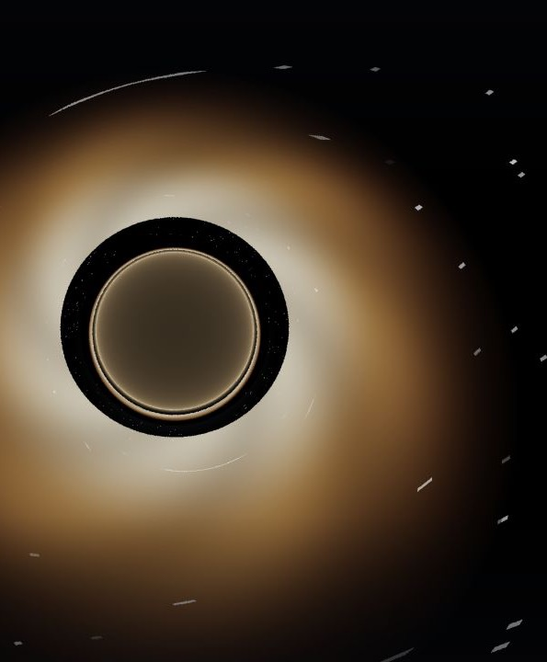
THE SYNTHESIS
Small codebase.
Real geodesics.
Honest boundaries.
1
The shader’s curvature equation is the scientific center of gravity.
2
WebGL2 makes that math visible and interactive at pixel scale.
3
The next leap is validation and light transport — not a bigger claim.
DRAG TO ORBIT · SCROLL TO ZOOM
13
Notes:
Close by returning to the project’s strength: a compact, inspectable implementation that turns a real Schwarzschild null-geodesic equation into an interactive visual. The documentation package preserves both the achievement and its limits.
[Sources]
- Blackhole Simulation/README.md:1-29
- Blackhole Simulation/shaders/fragment.glsl:14-188
- Blackhole Simulation/js/main.js:157-223
- /private/tmp/vac-blackhole-high-inclination.jpg (runtime capture from the project)
[/Sources]

